Slide 1
Introduction to DevOps
Sonika Rathi
Assistant Professor
BITS Pilani

Slide 2
Agenda
DevOps Practices
Five categories of DevOps Practice
Common terminology

Slide 3
DevOps Practices
Five different categories of DevOps practices
Treat Ops as first-class citizens from the point of view of requirements
Make Dev more responsible for relevant incident handling
Enforce the deployment process used by all, including Dev and Ops personnel
Use continuous deployment
Develop infrastructure code, such as deployment scripts

Slide 4
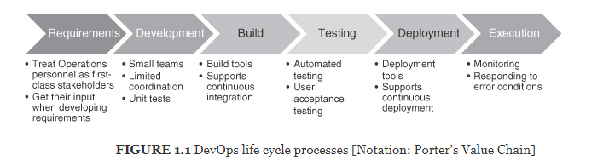
DevOps Practices
DevOps life cycle processes by Porter’s value chain

Slide 5
DevOps Practices
Common terminology used
IT professional
help desk support
operator, and operations personnel
hands-on access to the hardware—installing and configuring hardware, managing backups, and maintaining printers
System administrator
responsible for uptime, performance, resources, and security of computer systems
Note :We will use term operator though out the course refer to anyone who performs computer operator or system administration tasks (or both)

Slide 6
Thank You!
In our next session:

